Slide 1

Circular Linked List

Slide 2

Circular linked list
Circular singly linked list
Circular linked list is a sequence of elements in which every element has a link to its next element in the sequence and the last element has a link to the first element.
circular linked list is similar to the single linked list except that the last node points to the first node in the list

Slide 3
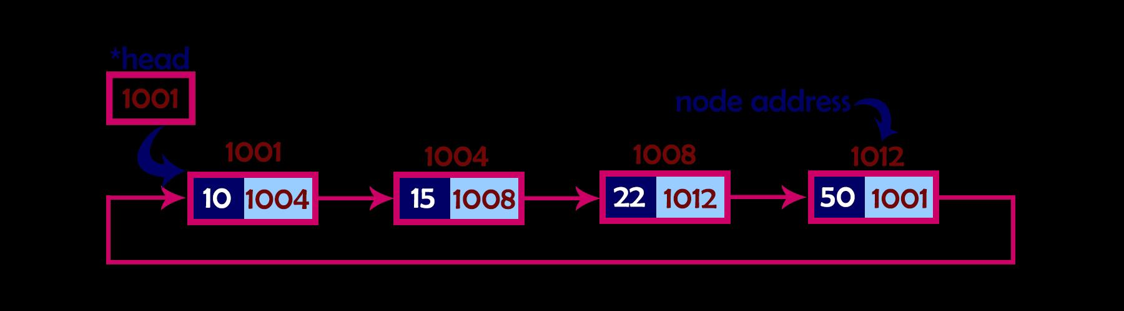
Circular linked list

Slide 4
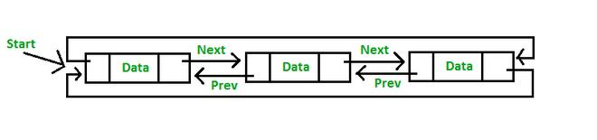
Circular linked list
Circular Doubly Linked List has properties of both doubly linked list and circular linked list in which two consecutive elements are linked or connected by the previous and next pointer and the last node points to the first node by the next pointer and also the first node points to the last node by the previous pointer.

Slide 5
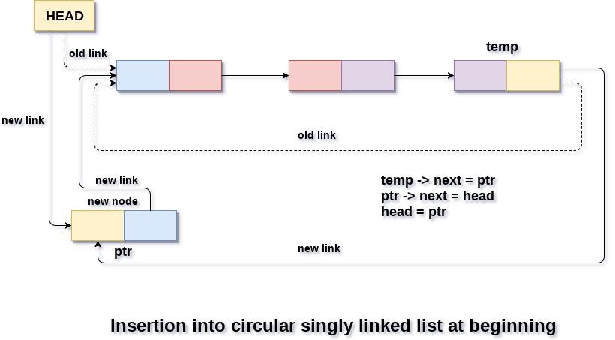
Insertion-At First

Slide 6
Insertion
Step 1: Create 2structure pointer variables ptr, newnode
IF PTR = NULL
Allocation not possible Go to Step 11 Else go to step2
Step 2: SET NEW_NODE = PTR
Step 3: SET PTR ->DATA=ITEM
Step 4: if HEAD=NULL Then go to step 5 else go to step7
SET HEAD=PTR
SET PTR->NEXT=HEAD
Step 7:TEMP=HEAD
Step 8: Check TEMP->NEXT! =head
SET TEMP = TEMP -> NEXT
[END OF LOOP]
Step 8: SET PTR -> NEXT = HEAD
Step 9: SET TEMP → NEXT = PTR
Step 10: SET HEAD = PTR
Step 11: EXIT

Slide 7
Void beg_insert(int item) {{ struct node *ptr = (struct node *)malloc(sizeof(struct node)); struct node *temp; if(ptr == NULL) { printf(“\allocation not possible”); } else { ptr -> data = item; if(head == NULL) { head = ptr; ptr -> next = head; } else { temp = head; while(temp->next != head) temp = temp->next; ptr->next =head temp -> next = ptr; head = ptr; } printf(“\nNode Inserted\n”); } }

Slide 8
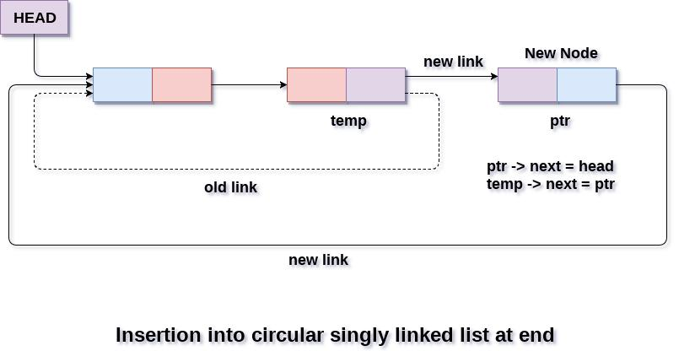
Insertion-At end

Slide 9
Insertion-At end
Step 1: IF PTR = NULL Write allocation not possible [END OF IF] Step 2: SET NEW_NODE = PTR Step 3: SET PTR ->DATa=ITEM
STEP 4:IF head==Null, then go to next step else go to step6 SET Head=ptr SET PTR-> NEXT = HEAD Step 6: SET TEMP = HEAD Step 7: Repeat Step 8 while TEMP -> NEXT != HEAD Step 8: SET TEMP = TEMP -> NEXT [END OF LOOP] Step 9: SET TEMP -> NEXT = PTR
Step 10: PTR->next=Head Step 11: EXIT

Slide 10
Insertion-At end
Void lastinsert(struct node*ptr, struct node *temp, int item) { ptr = (struct node *)malloc(sizeof(struct node)); if(ptr == NULL) { printf(“\nAllocation not possible\n”); } else { ptr->data = item; if(head == NULL) { head = ptr; ptr -> next = head; } else { temp = head; while(temp -> next != head) { temp = temp -> next; } temp -> next = ptr; ptr -> next = head; } } }

Slide 11
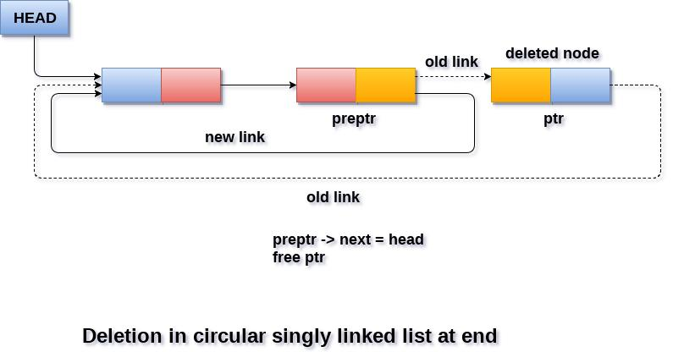
Deletion At beginning

Slide 12
Deletion At beginning
1) Create 2pointers Ptr, TEMP
2) IF HEAD = NULL, go to step3
3) print No elements to delete Go to Step 11 [END OF IF]
Step 4: SET PTR = HEAD
Step5:check ptr->next=head
Step6 :Head=Null
Step7: Free(ptr) go to step15
Step 8:Repeat Steps 9 while PTR -> NEXT != HEAD
Step 9:SET PTR = PTR -> NEXT
[END OF LOOP]
Step10:Temp=Head
Step 11: SET HEad=head->next
Step12print the deleted node is temp->Data
Step 13:ptr->next=head
Step 14:FREE TEMP
Step 15:EXIT

Slide 13
Deletion at end
Step1) create 2 Structure variable pointers temp, back, set temp=head
Step2) check temp->next! =head, if true go to step3, repeat step 3,4 untill condition is true
Step3) set back=temp
Step4) temp=temp->next
Step5) back->next=head
Step6) deleted item is temp->data
Step7) free(temp)
Step8) stop

